Slide 1
Texture Mapping
CS 460: COMPUTER GRAPHICS

Slide 2
Lecture outline
Texture Mapping Concept
Texture Filtering:
  Mip Maps and Summed Area Table
4. More Texturing Methods
Texture Mapping Issues in OGL
Good Example: Google Earth!

Slide 3
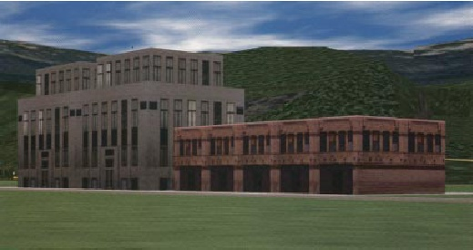
Texture Mapping
Texture mapping allows you to take a simple polygon and give it the appearance of something much more complex
  Due to Ed Catmull, PhD thesis, 1974

Slide 4
What do we need to texture map?
We want to color a pixel using colors from a texture
Given a texture, what to do with it?
  First, we need to know which part of texture corresponds to the pixel. We need a mapping.
  Second, we need to know the average texture color contributing to the pixel. We need texture filtering.

Slide 5
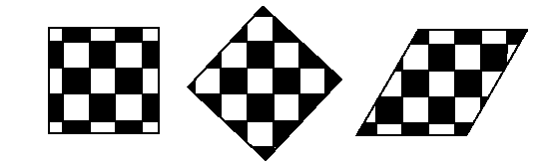
Non-Parametric Texture Mapping
With non-parametric texture mapping:
  Texture size and orientation are fixed
  Unrelated to size and orientation of polygon

Slide 6
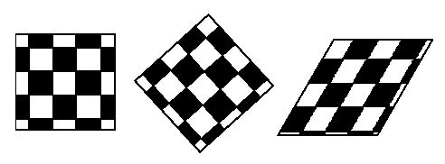
Parametric Texture Mapping
With parametric texture mapping, texture size and orientation are tied to the polygon:
  Separate texture space and screen space
  Texture the polygon as before but in texture space
  Deform (render) the textured polygon into screen space

Slide 7
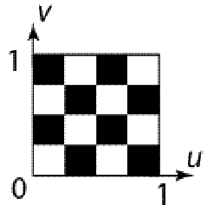
Texture Space: uv
A texture lives in its own image coordinates
paramaterized by (u,v) s.t. u∈[0,1] and v∈[0,1]
texel (texture element)
e.g. a 4x4 texture
Note:
If the given image’s resolution is width x height, each texel
is of size ( 1/width , 1/height ) in the uv space and the texel value
(e.g. RGB) should locate exactly at the center of the texel
width and height are usually powers of 2 for ease of computation

Slide 8
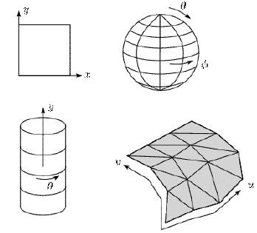
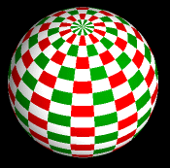

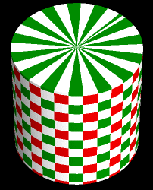
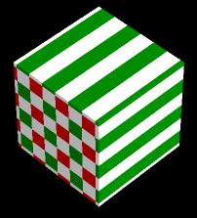
Implementing Texture Mapping
We can wrap the texture around many different surfaces:
v
v
u
u
v
v
u
u

Slide 9
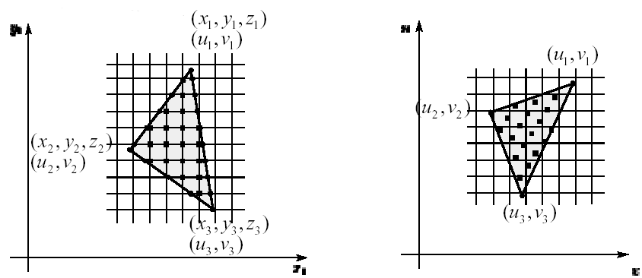
Implementing, cont’d
Inverse map from pixel to texel
Texture mapping can be handled by
rasterization in screen space
  User provides texture coordinates for the primitive vertices
  Texture coordinate at each interior pixel can be found by
  Gouraud-style interpolation
screen space
texture space

Slide 10
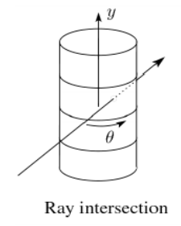
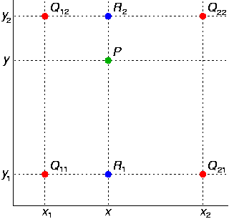
Texture Resampling
What do we do when the texture sample lands between texel center?
We resample. Common choice is bilinear resampling: bilinear interpolates the four neighboring texel values.

Slide 11
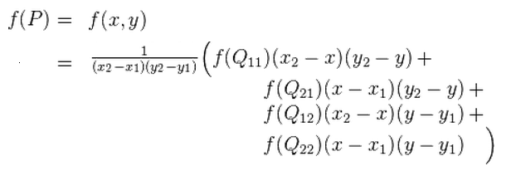
Bilinear Resampling
This Bilinear
Resampling
Pick up the
nearest texel
Note:
GL_LINEAR and
GL_NEAREST mode
in OGL texturing

Slide 12
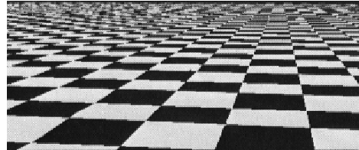
Antialiasing
If you point-sample the texture map, you get aliasing
(stair-casing effect):

Slide 13
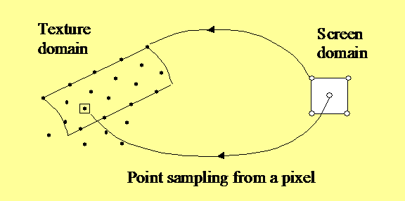
Reason for the Aliasing
Instead of mapping to one single point in the texture uv space, each pixel actually maps to an area in the texture space
a pixel in
screen
domain
corresponding
texel
a single pixel on screen may correspond
to thousands of texels in the texture

Slide 14
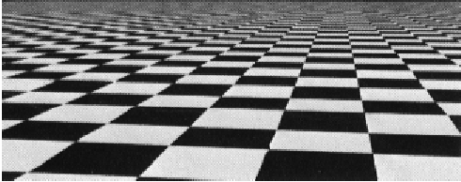
Anti-aliasing
Proper anti-aliasing requires area averaging in the texture:

Slide 15
Computing Average Colors
Computationally difficult part is prefiltering (summing) over the covered pixels:
Several methods have been used:
1. Brute force
  Just sum (mean filter)
  Hardware can now do
  anisotropic filtering
2. Mip maps
3. Summed Area Tables
i.e. sum all texels in this patch, take average
a pixel in
screen
domain
corresponding
texel
a single pixel on screen may corresponds
to thousands of texels in the texture

Slide 16
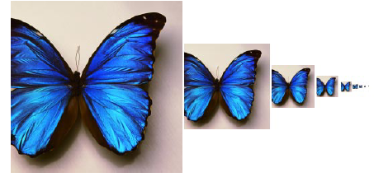
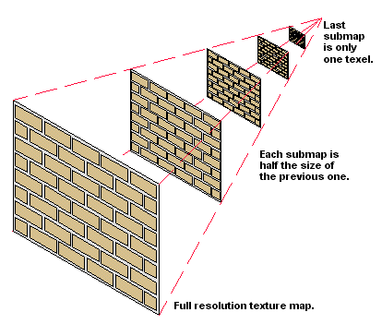
Mip Maps
Lance Williams, 1983
  Pre-process input textures by prefiltering it at different resolutions
  Use distance from observer to choose texture
    Essentially, closer objects use higher resolution texture
    Farther objects use lower resolution (blurred) texture
    To reduce aliasing effects
  Figure out two closest levels w.r.t. the mapped area in uv space
  Linearly interpolate between the two nearest level
  (in addition to bilinear interpolation on each level
  -> trilinear interpolation)

Slide 17
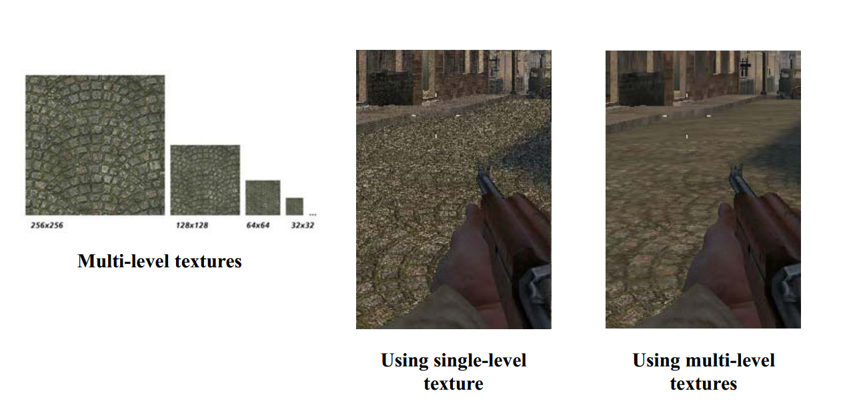
Mip Maps

Slide 18
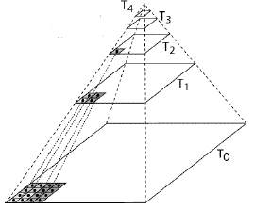
Mip Map Pyramid
The mip map hierarchy can be thought of as an image pyramid:
  Level 0 (T0[i,j]) is the original image
  Level 1 (T1[i,j]) averages over 2x2 neighborhoods of T0
  Level 2 (T2[i,j]) averages over 2x2 neighborhoods of T1
  Level 3 (T3[i,j]) averages over 2x2 neighborhoods of T2
  ……

Slide 19
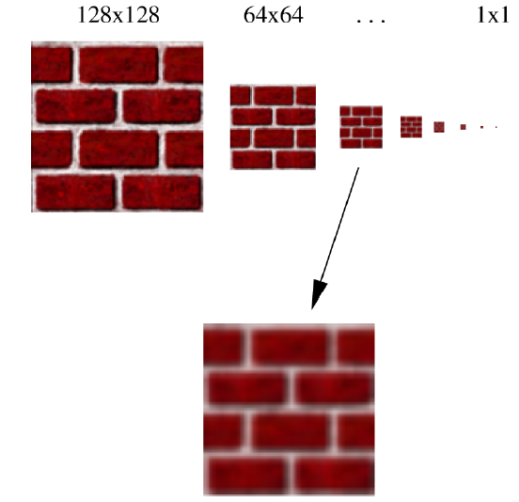
Mip Maps
Interpolate between levels:
1. Figure out two closest levels
2. Linear interpolate between
the two

Slide 20
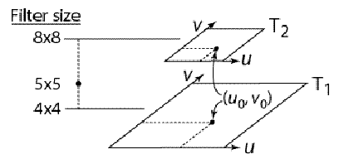
Mip Map Resampling
What would the mip map return for an average over a 5x5 neighborhood at location (u₀,v₀)?
OGL: GL_[NEAREST,LINEAR]_MIPMAP_[NEAREST,LINEAR]
Trilinear interpolation details:
http://en.wikipedia.org/wiki/Trilinear_interpolation

Slide 21
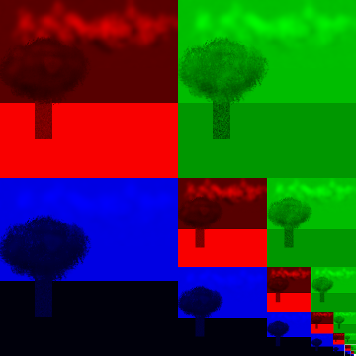
Storing Mip Maps
If it is an RGB Mip Map, we can store it like this:
What is the size of the additional storage?
1/3 of original texture size
R
G
R
G
B
R
G
B
B

Slide 22
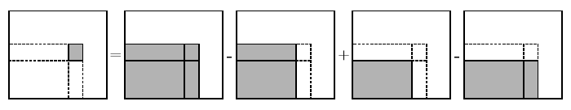
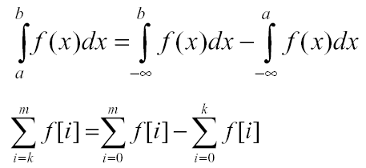
Summed Area Table (SAT)
Another approach to find the mapped area in the texture domain
Recall in Calculus (in continuous or discrete form):

Slide 23
What is a SAT?
Summing along this...
5 0 9 9
4 7 8 8
0 0 3 7
1 6 8 3
10 23 51 78
5 18 37 55
1 7 18 28
1 7 15 18
Summing along this...

Slide 24
Summed Area Table
Area we want to find
Due to Frank Crow (1984).
Keep sum of everything below and to the left.
Use four table lookup.
Requires more memory (2-4 times the original)
Gives less blurry results.

Slide 25
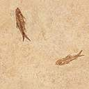
Summed Area Table (SAT)
Determining the rectangle:
  Find bounding box and calculate its aspect ratio
Bounding
box
v
y_{s}
pixel
x_{s}
u
Black Polygon is the mapped region.

Slide 26
Summed Area Table (SAT)
Determine the rectangle with the same aspect ratio as the bounding box and the same area as the pixel mapping (i.e. the black polygon).
v
y_{s}
a pixel
x_{s}
u

Slide 27
Summed Area Table (SAT)
Center this rectangle around the bounding box center.
Formula:
    Area = width*height = x*(x*aspect_ratio)
    Solve for x, the width of the rectangle
Other derivations are also possible using the aspects of the diagonals, …

Slide 28
Summed Area Table (SAT)
Calculating the color
  We want the average of the texture element colors within this rectangle
(u4,v4)
(u3,v3)
v
+
-
-
+
(u1,v1)
(u2,v2)
+
-
+
-
u
4 areas in the SAT

Slide 29
Summed Area Table (SAT)
To get the average, we need to divide by the number of texels falling in the rectangle.
  Color = SAT(u3,v3)-SAT(u4,v4)-SAT(u2,v2)+SAT(u1,v1)
  Color = Color / ( (u3-u1)*(v3-v1) )
(SUM)
(AVERAGE)
This is the resulting color we get from this texture mapping

Slide 30
More Texturing Methods
Solid Texture / Volume Texture
- available in OGL 1.1
Bump Mapping
- not in OGL 1.1, needs advanced OGL (Shader Support)
Displacement Mapping
- not in OGL 1.1, needs advanced OGL (Shader Support)
Environment Mapping
- not fully supported in OGL 1.1, advanced OGL has Cubemap.
……

Slide 31
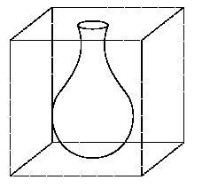
Solid Textures / Volume Textures
Q: What kinds of artifacts might you see from using a marble wallpaper instead of a real marble?
  One solution is to use solid textures / volume textures.
  Use model-space coordinates to index (3D texture coordinates) into a 3D texture.
  Like “carving” the object from the material
The mathematics is easy and the pre-filtering is much easier, but creating the solid texture is difficult…
Place the vase into a 3D marble texture

Slide 32
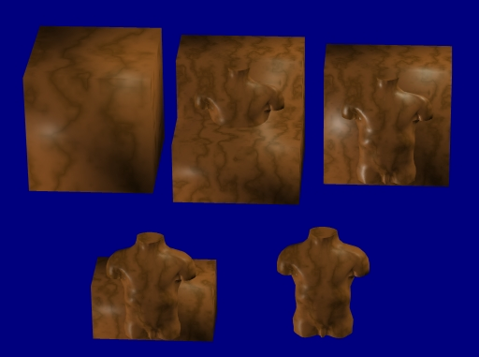
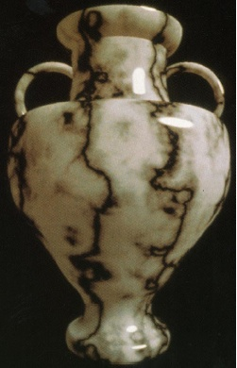
Example Solid Textures
Object Carving
[Perlin85]

Slide 33

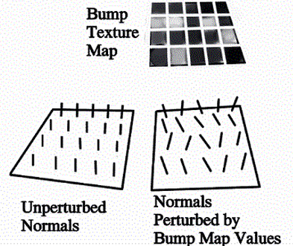
Bump Mapping
Textures can be used for more than just color
In bump mapping, a texture is used to perturb the normal:
  The normal is perturbed
  according to an additional
  texture.
  Look at the silhouette
  carefully!

Slide 34
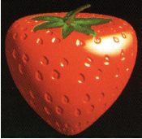
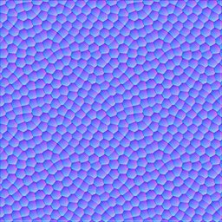
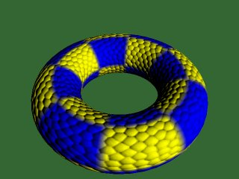
Bump Mapping

Slide 35
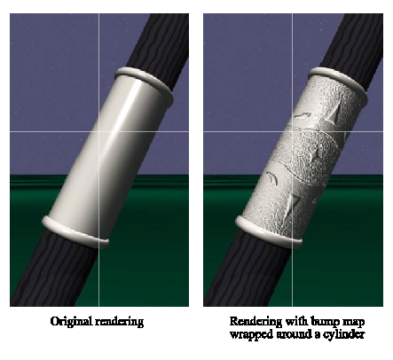
Bump Mapping Example

Slide 36
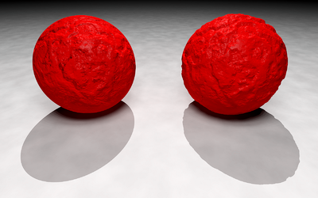
Bump Mapping Example
Bump mapping
Real “bumpy geometry”
Smooth shadow
Bumpy shadow

Slide 37
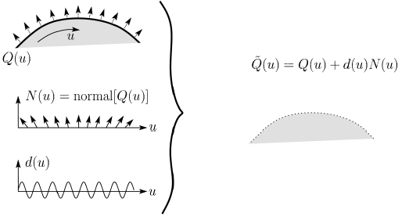
Displacement Mapping
In displacement mapping, a texture is used to perturb the surface geometry itself:
Silhouettes are correct.
Requires doing additional hidden surface calculations.

Slide 38
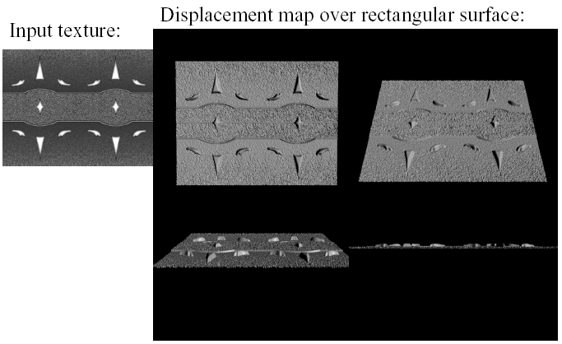
Displacement Mapping
Note the self-shadow
created by the displaced geometry

Slide 39
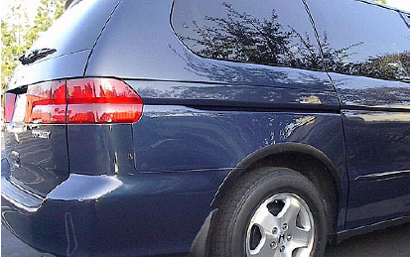
Environment Mapping (in real-life)

Slide 40
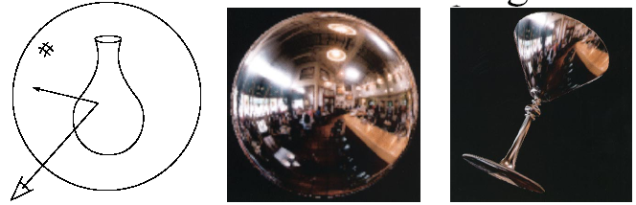
Environment Mapping
A.k.a. reflection mapping
Use texture to model object’s environment (view dependent!)
Rays are bounced off objects into environment to determine color of illumination
Works well when there is just a single object
With some simplifications can be implemented in hardware
Ray tracer can be extended to handle refractions as well

Slide 41
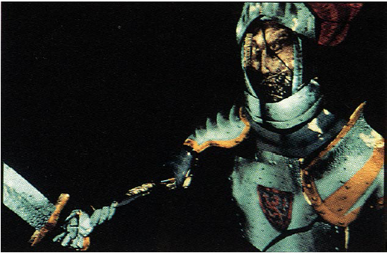
Combining Texture Maps
Combine several texture maps to achieve richer visual effects.

Slide 42
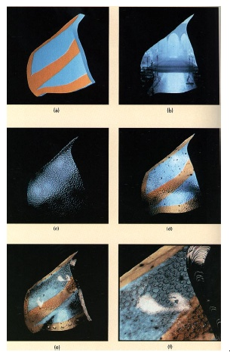
Combining Texture Maps
Base texture
Bump map
+ Specular (glossy)
Environ. map
+ Dirt
Close up (above)

Slide 43
Summary
What to take from this lecture:
What texture mapping is and what is it good for
Understanding the various approaches to antialiased textured mapping
  Brute force
  Mip Maps
  Summed area tables (SAT)
Additional effect with texture mapping techniques
  Solid Texture / Volume Texture, Bump mapping, Displacement mapping, Environment mapping, Combining Textures

